Slide 1

Chapter 2.1
Little’s Theorem and General Results
Performance Evaluation of the Internet of Things (IoT)
Module Course: Performance Evaluation of Distributed Systems
Prof. Tobias Hoßfeld, Summer Semester 2022

Slide 2
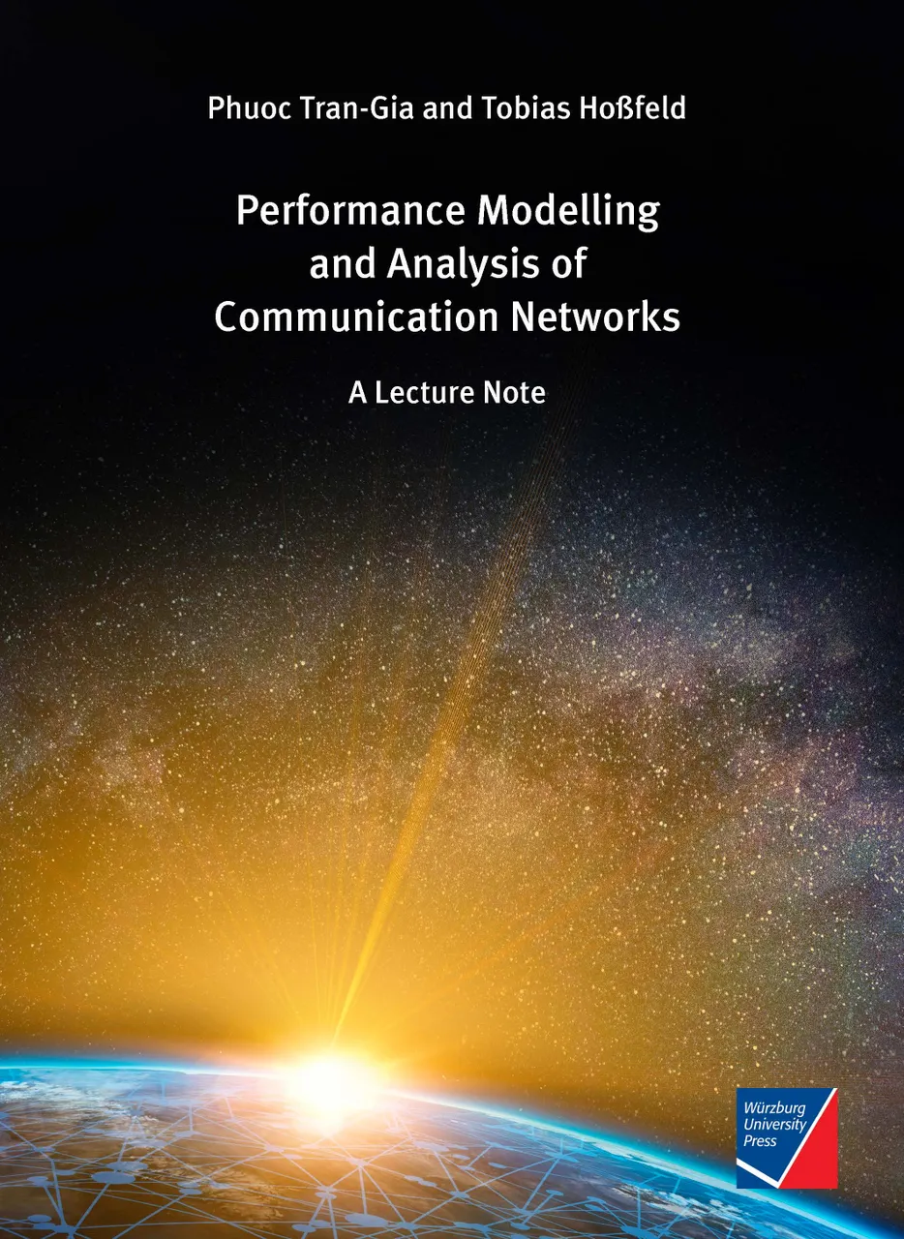
Disclaimer and Copyright Notice
Lecture slides, figures, and scripts are based on the open access text book “Performance Modeling and Analysis of Communication Networks”. The book and scripts are licensed under the Creative Commons License Attribution-ShareAlike 4.0 International (CC BY-SA 4.0). If you remix, transform, or build upon the material, you must distribute your contributions under the same license as the original.
The book must be cited and the disclaimer attached when using lectures slides or scripts.
Tran-Gia, P. & Hossfeld, T. (2021). Performance Modeling and Analysis of Communication Networks - A Lecture Note. Würzburg University Press. https://doi.org/10.25972/WUP-978-3-95826-153-2
Website to download book, exercises, slides and scripts: https://modeling.systems/

Slide 3
Chapter 2
2 Fundamentals and Prerequisites
2.1 Little’s Theorem and General Results
2.1.1 Little’s Law in Finite Systems with Blocking
2.1.2 Example: Multiclass Systems
2.1.3 Example: Balking
2.1.4 The Utilization Law
2.1.5 Assumptions and Limits of Little’s Law
2.1.6 General Results for GI/GI/n Delay Systems
2.1.7 Loss Formula for GI/GI/n-S Loss Systems
2.2 Probabilities and Random Variables
2.2.1 Random Experiments and Probabilities
2.2.2 Other Terms and Properties
2.2.3 Random Variable, Distribution, Distribution Function
2.2.4 Expected Value and Moments
2.2.5 Functions of Random Variables and Inequalities
2.2.6 Functions of Two Random Variables
2.3 Transform Methods
2.3.1 Generating Function
2.3.2 Laplace and Laplace-Stieltjes Transforms
2.4 Some Important Distributions
2.4.1 Discrete Distributions
2.4.2 Continuous Distributions
2.4.3 Relationship between Continuous and Discrete Distribution

Slide 4
Little‘s Theorem
Little‘s law or Little‘s result

Slide 5
Operational Laws
System is considered as a black box
Relation between quantities which do not require assumptions on the distribution of arrival times or service times
“Operational” means directly measurable during operation
Assumptions that can be verified during operation (in measurements).
For example: Is the number of arrivals equal to the number of completions?

Slide 6
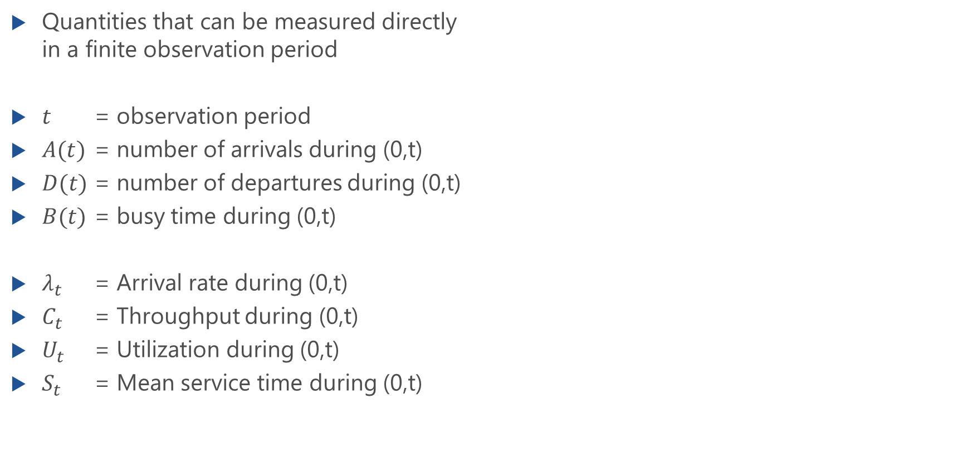
Operational Quantities
Quantities that can be measured directly in a finite observation period
$t$ = observation period
$A(t)$ = number of arrivals during (0,t)
$D(t)$ = number of departures during (0,t)
$B(t)$ = busy time during (0,t)
$λ_{t}$ = Arrival rate during (0,t)
$C_{t}$ = Throughput during (0,t)
$U_{t}$ = Utilization during (0,t)
$S_{t}$ = Mean service time during (0,t)
Black
Box
System
Notes:
Service time, not response time

Slide 7

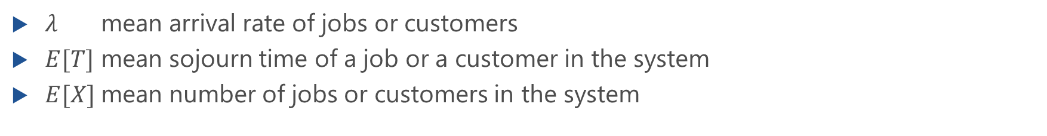
Little‘s Formula
Little‘s Formula $λ⋅E[T]=E[X]$
$λ$ mean arrival rate of jobs or customers
$E[T]$ mean sojourn time of a job or a customer in the system
$E[X]$ mean number of jobs or customers in the system

Slide 8
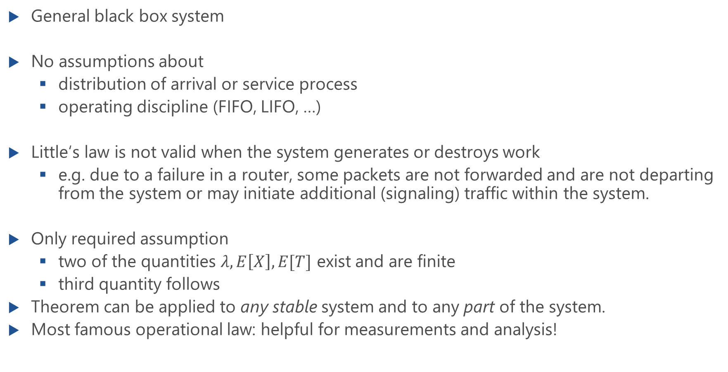
Assumptions of Little‘s Theorem
General black box system
No assumptions about
distribution of arrival or service process
operating discipline (FIFO, LIFO, …)
Little‘s law is not valid when the system generates or destroys work
e.g. due to a failure in a router, some packets are not forwarded and are not departing from the system or may initiate additional (signaling) traffic within the system.
Only required assumption
two of the quantities $λ,E\left[X\right],E[T]$ exist and are finite
third quantity follows
Theorem can be applied to any stable system and to any part of the system.
Most famous operational law: helpful for measurements and analysis!

Slide 9
Simple Example of Little‘s Law
Example 1: Waiting room at the doctor's
Arrival rate 10 patients/hour
Mean waiting time: 0.5 hours
Mean number of patients?
Example 2: Waiting room at the doctor's
Arrival rate 10 patients/hour
Mean waiting time: 1.2 hours
Mean number of patients?

Slide 10
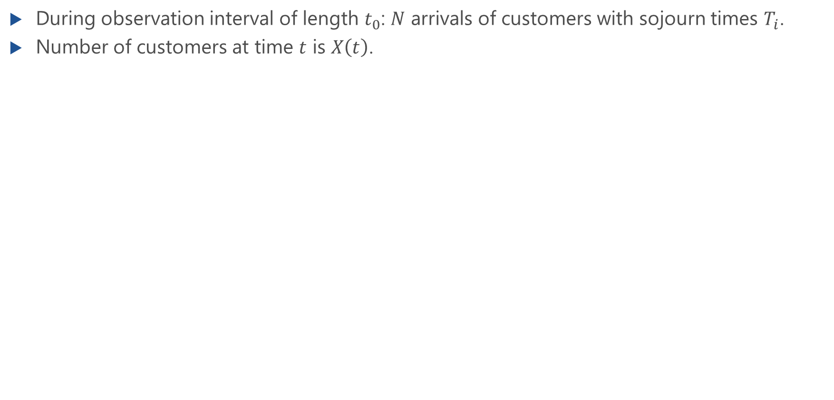
Proof of Little‘s Theorem
During observation interval of length $t_{0}$: $N$ arrivals of customers with sojourn times $T_{i}$.
Number of customers at time $t$ is $X\left(t\right)$.
→
→

Slide 11
lecture

Slide 12
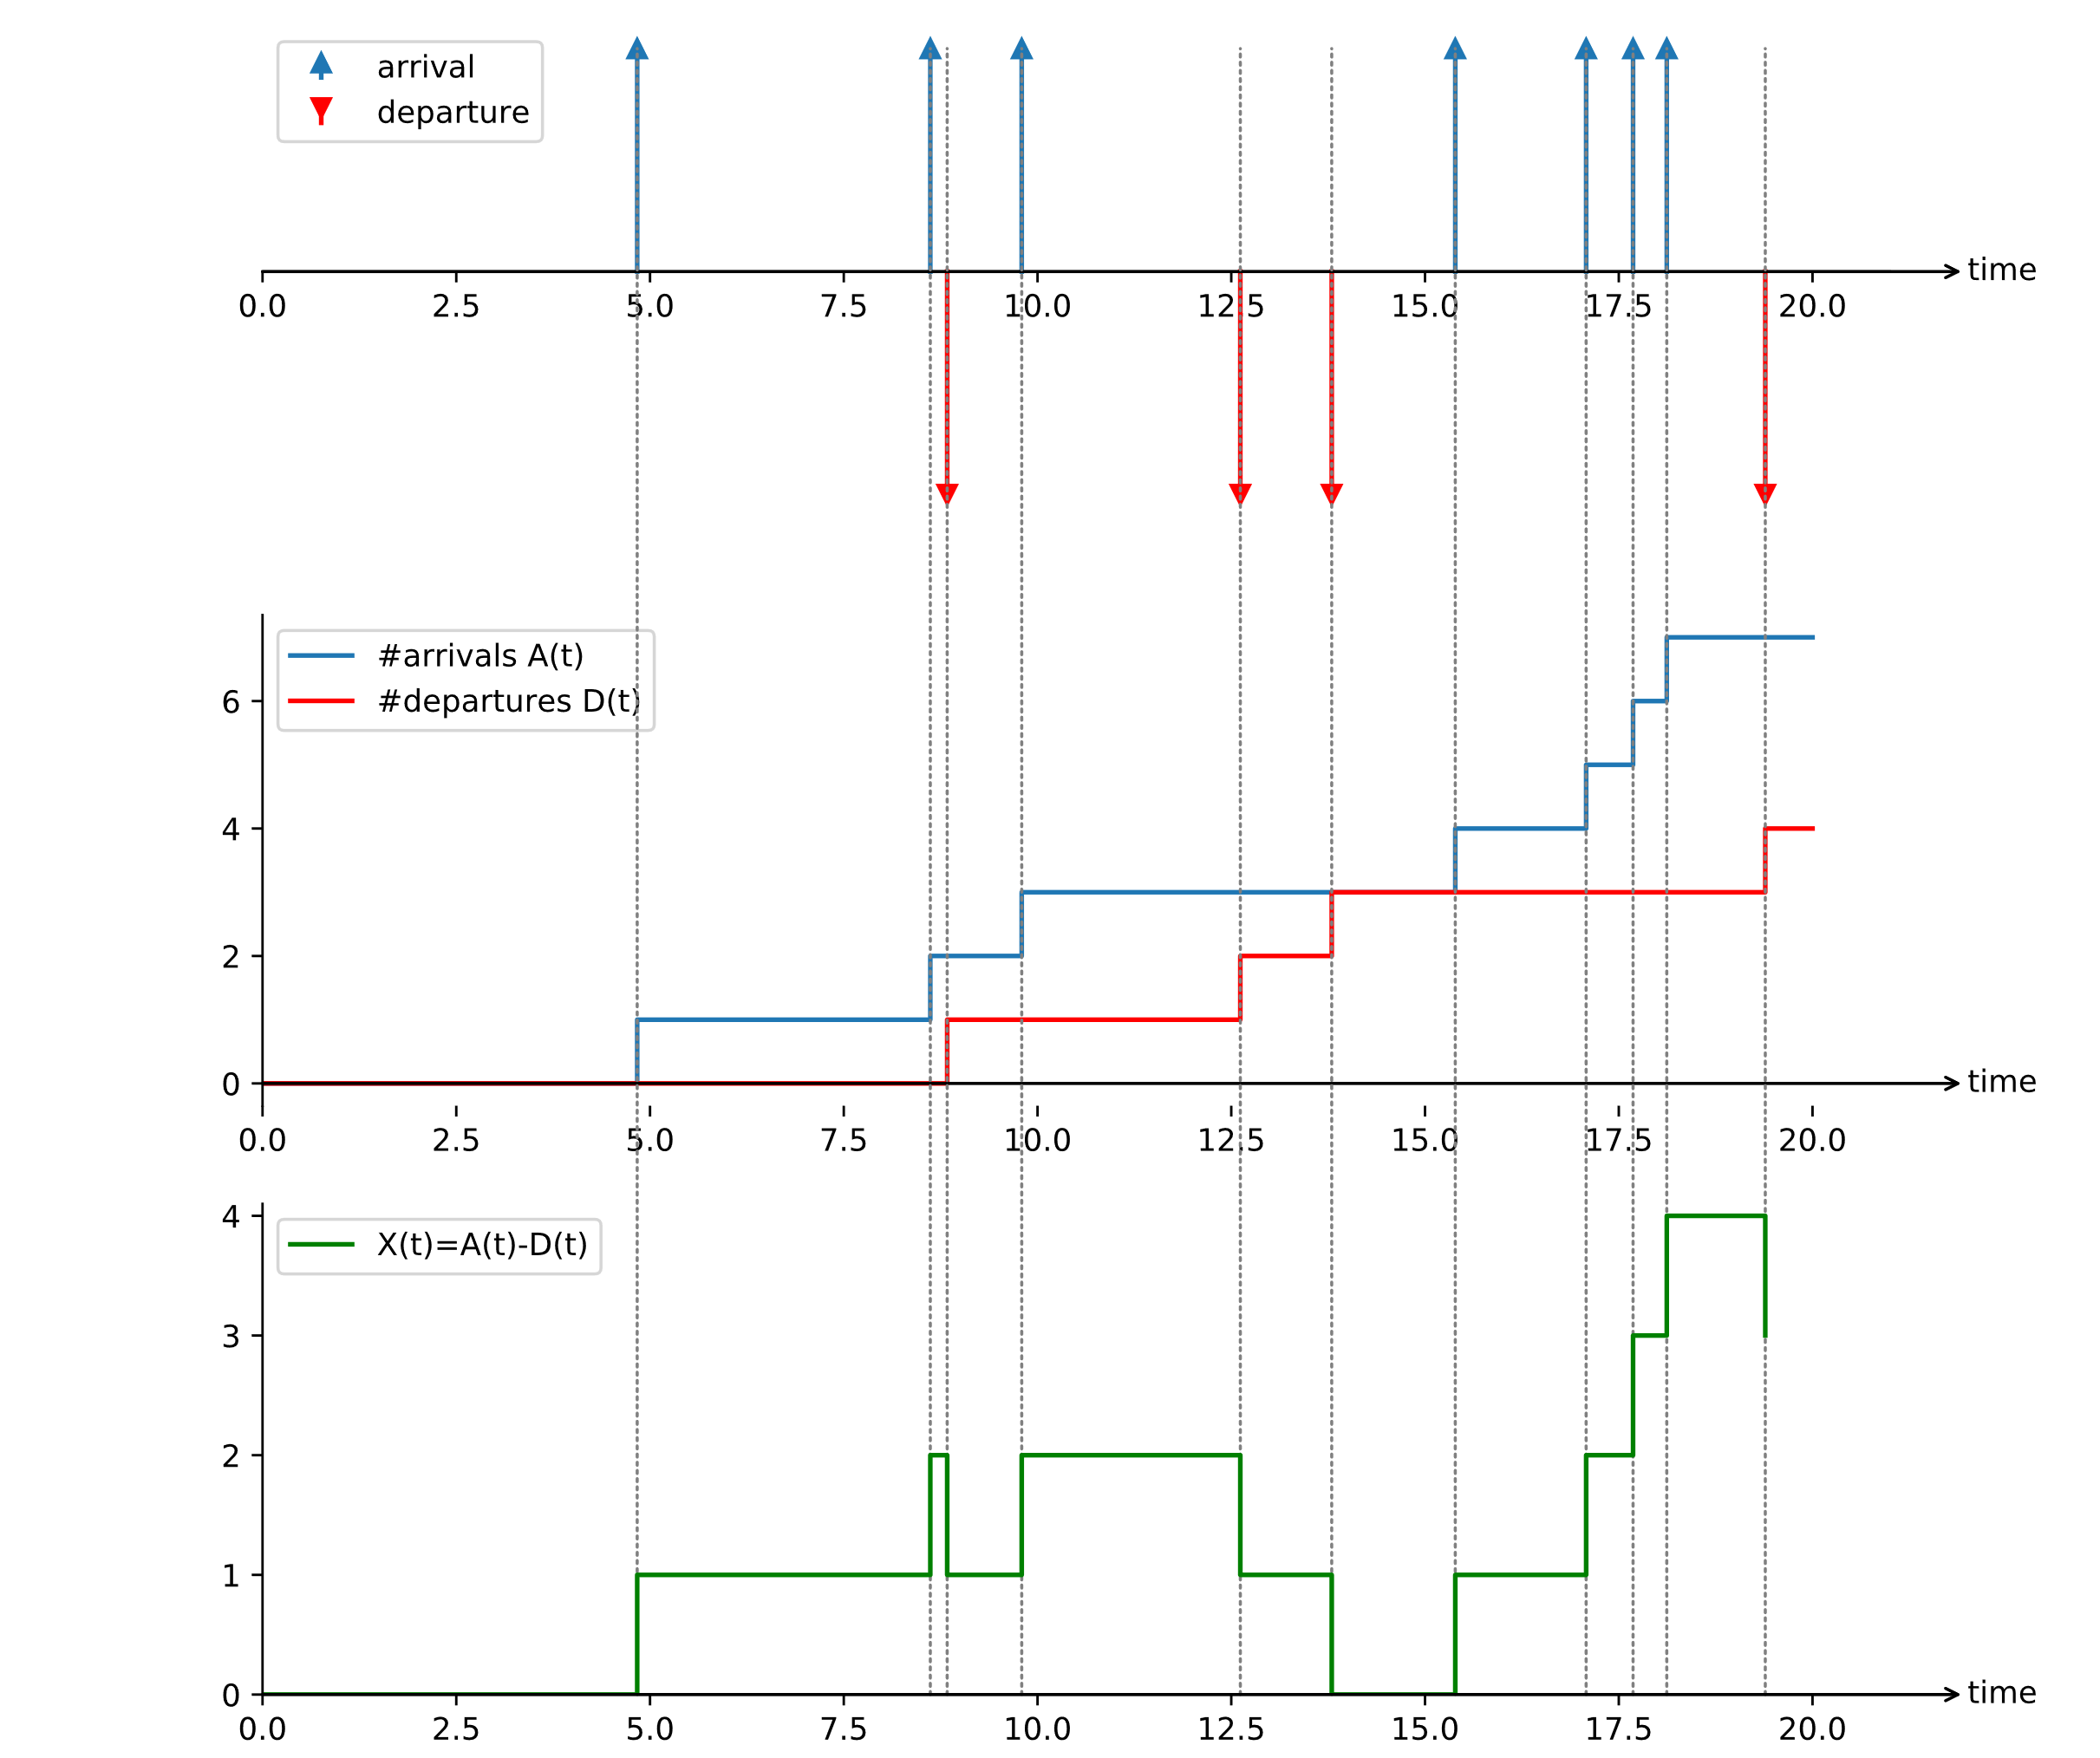
Little‘s Law: Visualization (M/D/1)
A(t)
D(t)
X(t)

Slide 13
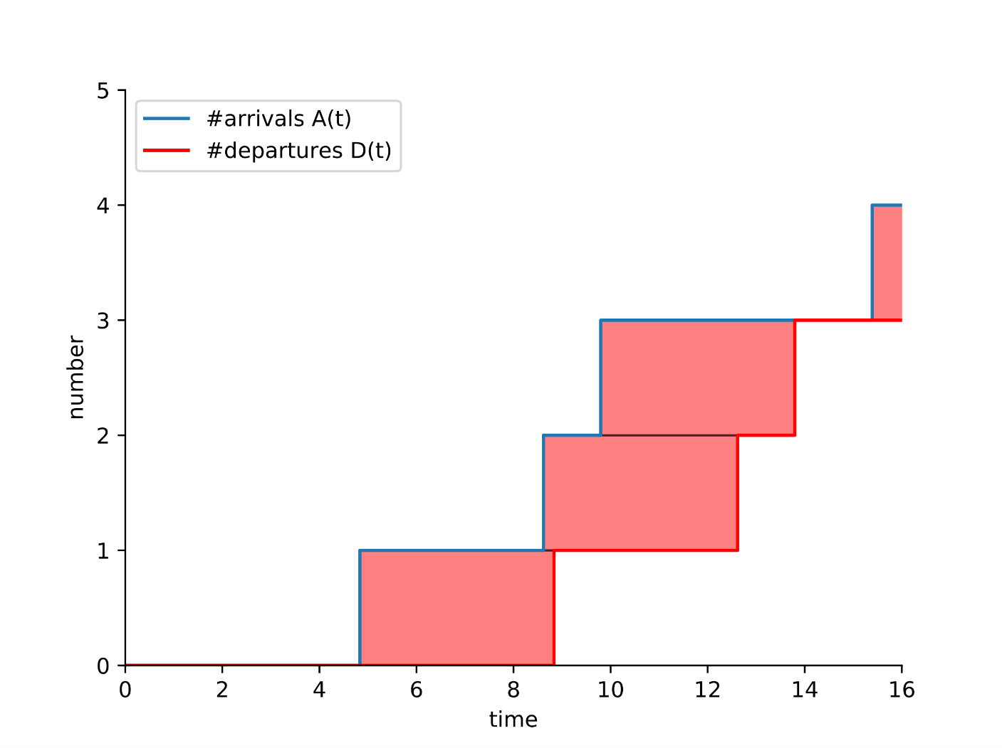
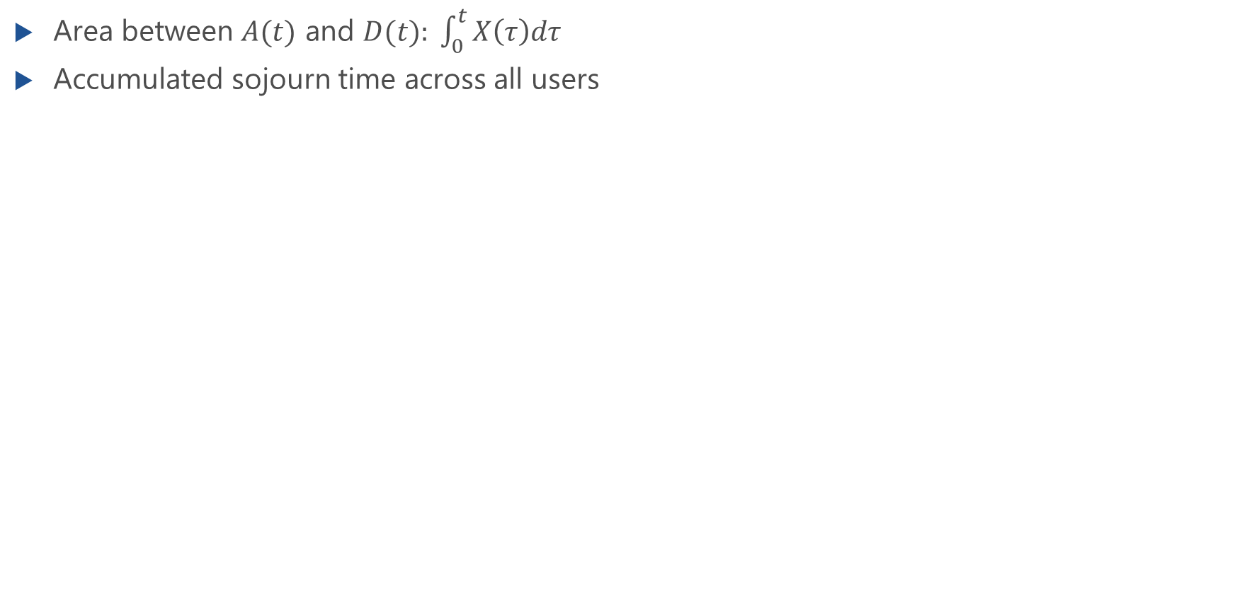
Accumulated Sojourn Time
Area between $A(t)$ and $D(t): \int_{0}^{t}{X\left(τ\right)dτ}$
Accumulated sojourn time across all users
user 3
user 2
user 1

Slide 14
Queueing Discipline
Do we observe the same mean waiting times for FIFO (first-in first-out) and LIFO (last-in first-out)?

Slide 15
Little‘s Law: Network of Queues
Theorem can be applied to any stable system and to any part of the system.
inbound
outbound

Slide 16
Little‘s Theorem: Finite System with Blocking
Loss system GI/GI/n-S

Slide 17
Finite System with Blocking
Loss system GI/GI/n-S

Slide 18
lecture

Slide 19
Little‘s Theorem: Queueing Sytem with Balking
Arriving customers refusing to enter the queue

Slide 20
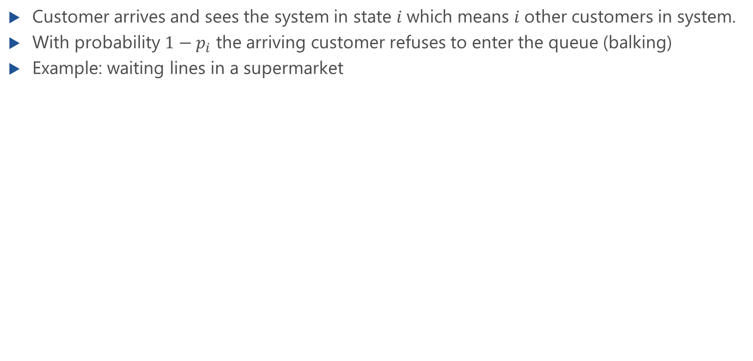
Queueing System with Balking
Customer arrives and sees the system in state $i$which means $i$other customers in system.
With probability $1−p_{i}$ the arriving customer refuses to enter the queue (balking)
Example: waiting lines in a supermarket

Slide 21
lecture

Slide 22
Utilization Law
Utilization of a server

Slide 23
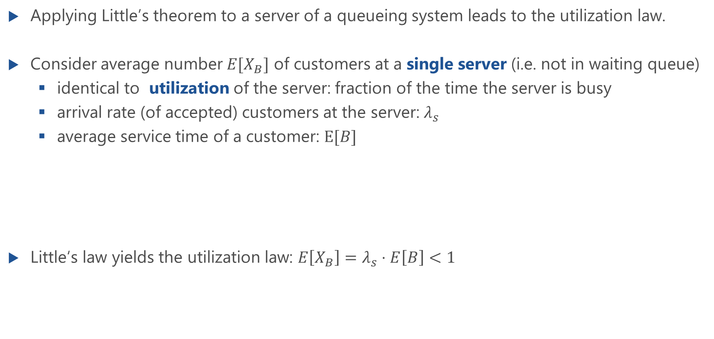
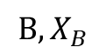
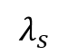
The Utilization Law
Applying Little’s theorem to a server of a queueing system leads to the utilization law.
Consider average number $E[X_{B}]$ of customers at a single server (i.e. not in waiting queue)
identical to utilization of the server: fraction of the time the server is busy
arrival rate (of accepted) customers at the server: $λ_{s}$
average service time of a customer: $E[B]$
Little‘s law yields the utilization law: $E\left[X_{B}\right]=λ_{s}⋅E\left[B\right]<1$
$$λ_{s}$$
$$B,X_{B}$$

Slide 24
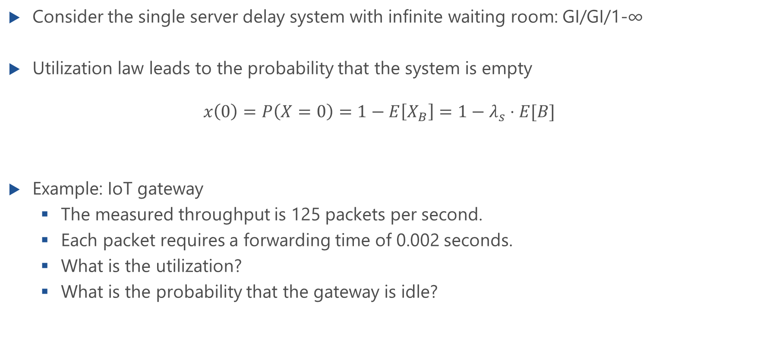
Delay System GI/GI/1-∞
Consider the single server delay system with infinite waiting room: GI/GI/1-∞
Utilization law leads to the probability that the system is empty
$$x\left(0\right)=P\left(X=0\right)=1−E\left[X_{B}\right]=1−λ_{s}⋅E[B]$$
Example: IoT gateway
The measured throughput is 125 packets per second.
Each packet requires a forwarding time of 0.002 seconds.
What is the utilization?
What is the probability that the gateway is idle?

Slide 25
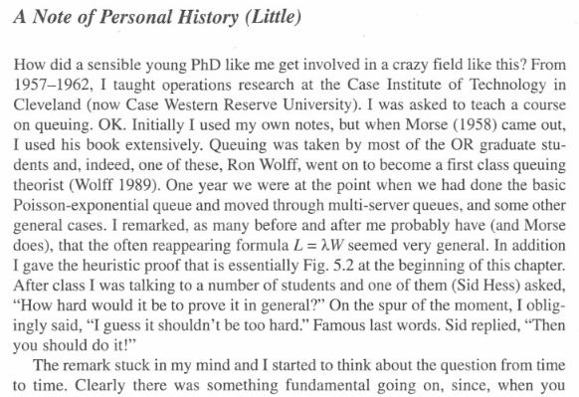
Serendipity…
Little, John DC, and Stephen C. Graves. "Little's law." Building Intuition. Springer US, 2008. 81-100.

Slide 26
General Results for Delay Systems
GI/GI/n delay systems

Slide 27
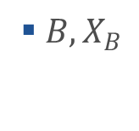
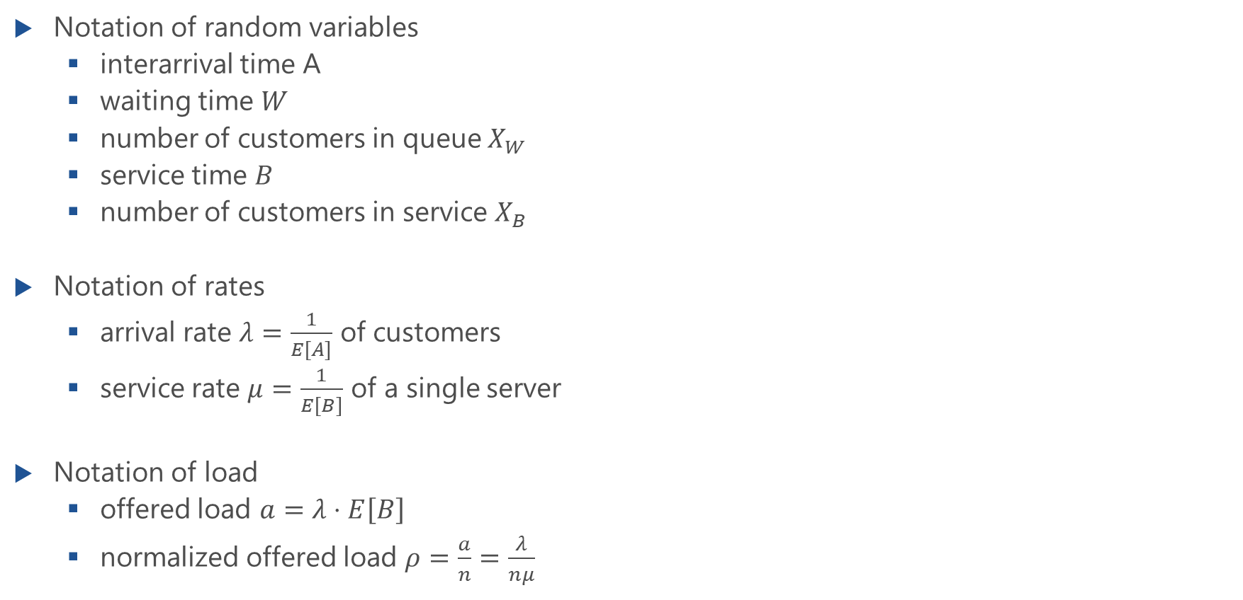
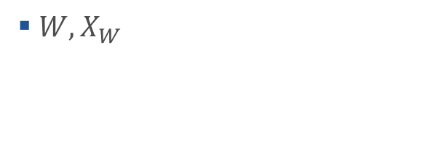
Notation
Notation of random variables
interarrival time A
waiting time $W$
number of customers in queue $X_{W}$
service time $B$
number of customers in service $X_{B}$
Notation of rates
arrival rate $λ=\frac{1}{E\left[A\right]}$ of customers
service rate $μ=\frac{1}{E\left[B\right]}$ of a single server
Notation of load
offered load $a=λ⋅E\left[B\right]$
normalized offered load $ρ=\frac{a}{n}=\frac{λ}{nμ}$
1
2
…
n
$W, X_{W}$
$B,X_{B}$

Slide 28
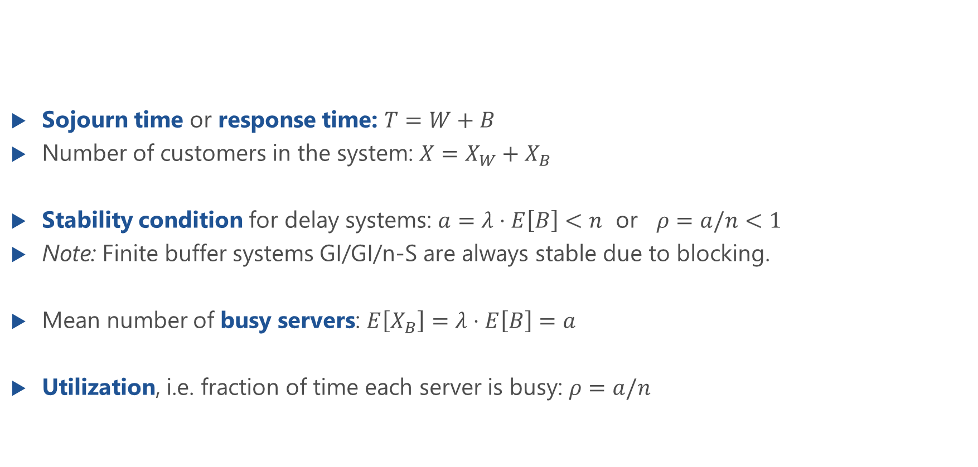
General Results for GI/GI/n Delay Systems
Sojourn time or response time: $T=W+B$
Number of customers in the system: $X=X_{W}+X_{B}$
Stability condition for delay systems: $a=λ⋅E\left[B\right]<n$ or $ρ=a/n<1$
Note: Finite buffer systems GI/GI/n-S are always stable due to blocking.
Mean number of busy servers: $E\left[X_{B}\right]=λ⋅E\left[B\right]=a$
Utilization, i.e. fraction of time each server is busy: $ρ=a/n$
1
2
…
n

Slide 29
Loss Formula
GI/GI/n-S loss systems

Slide 30
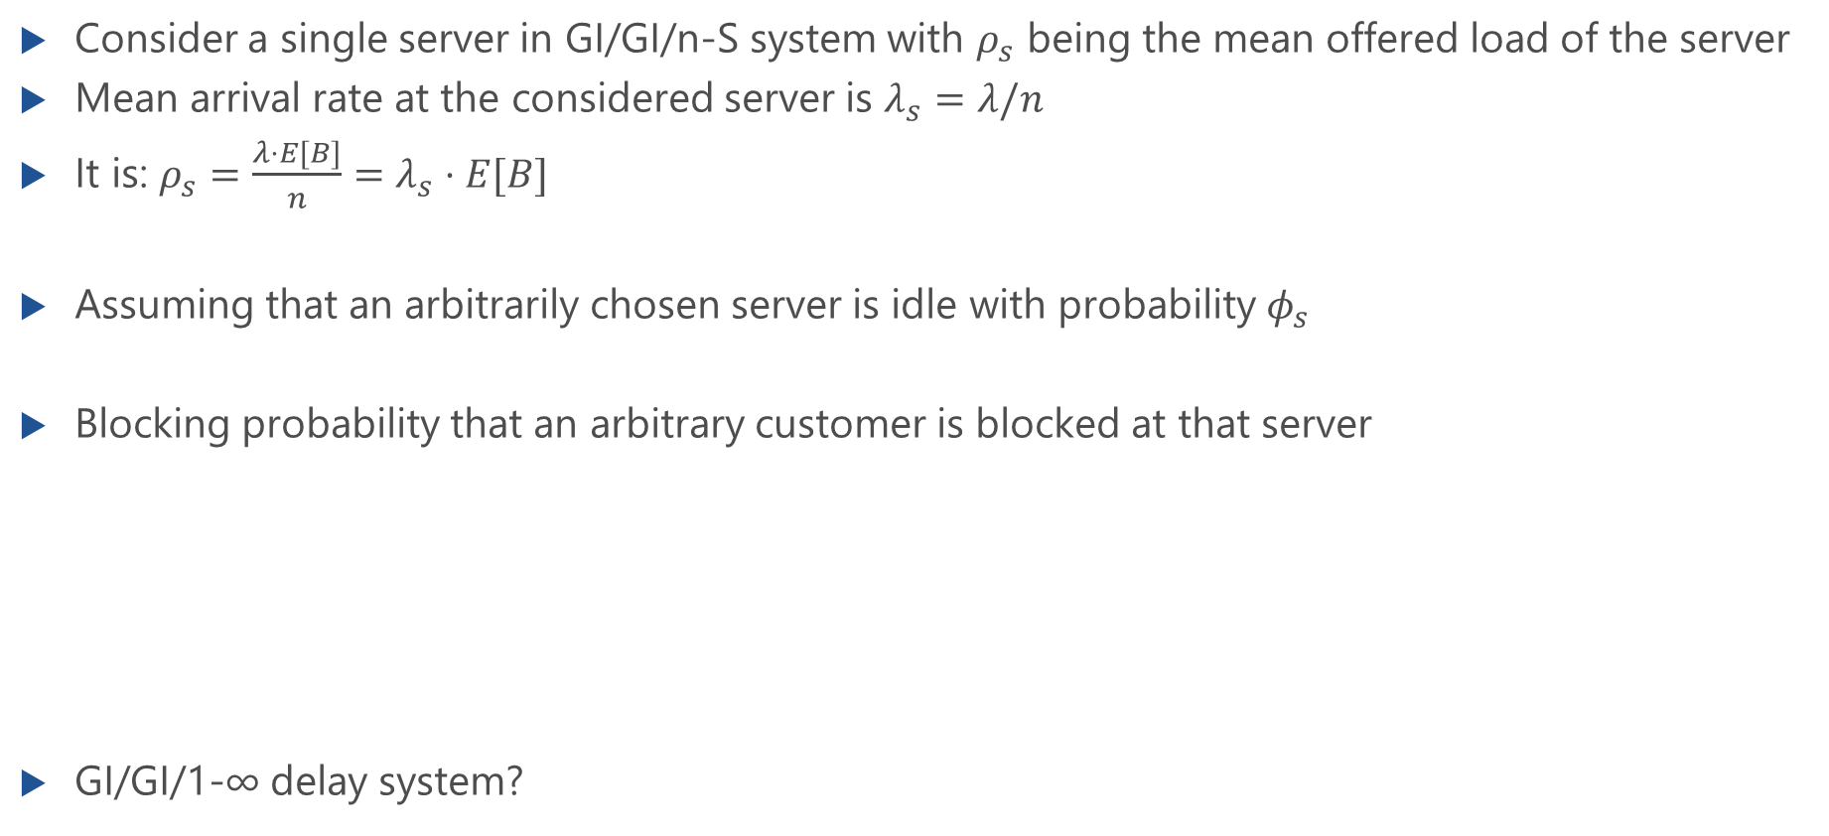

Loss Formula for GI/GI/n-S Loss Systems
Consider a single server in GI/GI/n-S system with $ρ_{s}$ being the mean offered load of the server
Mean arrival rate at the considered server is $λ_{s}=λ/n$
It is: $ρ_{s}=\frac{λ⋅E[B]}{n}=λ_{s}⋅E[B]$
Assuming that an arbitrarily chosen server is idle with probability $φ_{s}$
Blocking probability that an arbitrary customer is blocked at that server
GI/GI/1-∞ delay system?
loss formula $p_{B}=1−\frac{{1−φ}_{s}}{ρ_{s}}$

